Slide 1
MULTI DISEASE PREDICTION USING MACHINELEARNING

Slide 2
Abstract
Many existing machine learning models for health care analysis focus on a single disease. For example, one analysis could be for diabetes, another for cancer, and another for skin problems.
There is no universal approach that can forecast multiple diseases using a single analysis. By utilising the Flask API, this project proposes a system that can forecast different diseases. Liver Disease, pneumonia , skin disease, Hear Disease, Breast Cancer , pneumonia were all examined in this investigation.
In this project a system which used to predict multiple diseases by using Flask API.
In this project multiple disease prediction like heart disease, breast cancer, skin disease, pneumonia, liver disease, Breast cancer are predicted.
To implement multiple disease analysis used machine learning algorithms, TensorFlow and Flask API. Python pickling is used to save the model behavior and python unpickling is used to load the pickle file whenever required.

Slide 3
Introduction
During a lot of analysis over existing systems in health care analysis considered only one disease at a time
For example, article [1] is used to analyze diabetes, article [2] is used to analyze diabetes retinopathy, article [3] is used to predict heart disease [11]. Maximum articles focus on a particular disease. When any organization wants to analyze their patient’s health reports then they have to deploy many models. The approach in the existing system is useful to analyze only particular disease.
Now a day’s mortality got increased due to exactly not identifying exact disease. Even the patient got cured from one disease may be suffering from another disease

Slide 4
Existing System
Some existing systems used few parameters while analyzing the disease. Due to that may be not possible to identify the diseases which will be caused due to the effect of that disease. For example, due to diabetes, there may be chance of heart disease.
Many of existing analysis involved analyzing particular disease. When a user wants to analyze diabetes needs to use one analysis and same user wants to analyze heart disease then user has to use one more model. This is a time taking process.
And also if any user having more than one disease but in existing system if it is able to predict only one disease then there is a chance of mortality rate increase due to not able to predict the other disease in advance.

Slide 5
Disadvantages
Existing system works for only single disease and for each type of disease use should visit multiple websites to get predict disease
Existing methods use same algorithms for all disease predictions.
Some existing systems used few parameters while analyzing the disease. Due to that may be not possible to identify the diseases which will be caused due to the effect of that disease.

Slide 6
Proposed System
In multi disease model prediction, it is possible to predict more than one disease at a time. So user no need to traverse many models to predict the diseases. It will reduce time and also due to predicting multiple diseases at a time there is a chance of reducing mortality rate.
In proposed system in multiple disease like ( Liver Disease, pneumonia , skin disease, Hear Disease, Breast Cancer , pneumonia ) are trained using their own datasets and prediction model is used in website to predict disease based on user input.

Slide 7
Advantages
Single website is used to predict six type of diseases.
Each disease is trained with different algorithms
Time taken for training and prediction is less with high actuary.
Each disease prediction has different datasets and training process

Slide 8
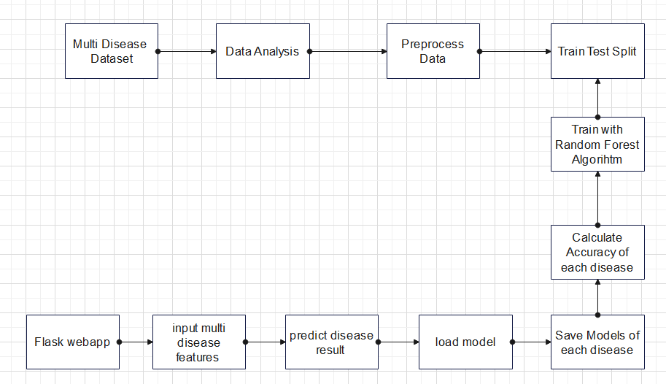
Architecture Diagram

Slide 9
Software Requirements
Operating system : Windows XP/7/10.
Coding Language : Python
Tool : Anaconda
Interface : OPENCV
Dataset : heart, skin, liver, kidney, breast cancer, pnemonia

Slide 10
Hardware Requirements
System : Intel(R) Core(TM) i3-7020U CPU @ 2.30GHz
Hard Disk : 1 TB.
Input Devices : Keyboard, Mouse
Ram : 4 GB.

Slide 11
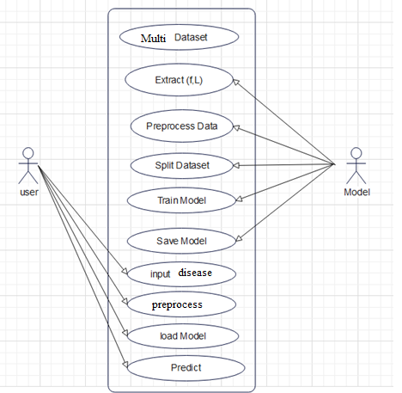
Use case diagrams

Slide 12
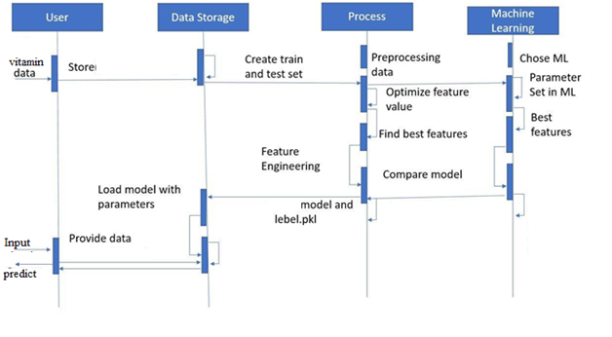
SEQUENCE DIAGRAMS

Slide 13
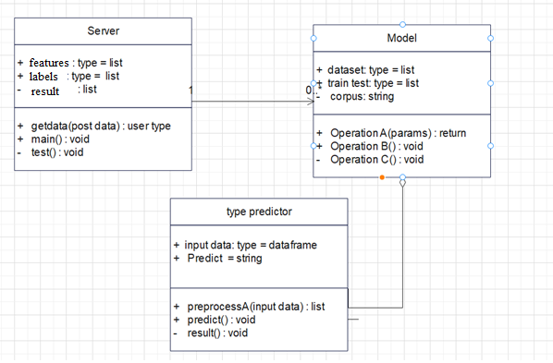
CLASS DIAGRAM

Slide 14
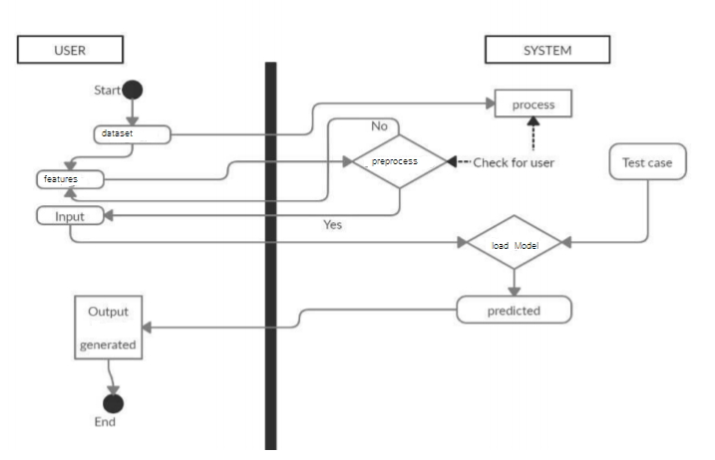
ACTIVITY DIAGRAM

Slide 15
CNN Algorithm
CNN is a Deep Learning set of rules that can absorb an enter photograph, assign significance to numerous aspects/gadgets withinside the photograph and have the ability to distinguish one from the different.
The pre-processing required in a CNN is a lot decrease in comparison to different type algorithms. While in primitive strategies filters are hand-engineered, with sufficient training, CNN have the capacity to examine those filters/characteristics.
The architecture of a ConvNet is analogous to that of the connectivity pattern of Neurons in the Human Brain and was inspired by the organization of the Visual Cortex.
Individual neurons respond to stimuli only in a restricted region of the visual field known as the Receptive Field. A collection of such fields overlaps to cover the entire visual area

Slide 16
Random Forest Algorithm
Random forest is a Supervised Machine Learning Algorithm that is used widely in Classification and Regression problems. It builds decision trees on different samples and takes their majority vote for classification and average in case of regression. One of the most important features of the Random Forest Algorithm is that it can handle the data set containing continuous variables as in the case of regression and categorical variables as in the case of classification. It performs better results for classification problems.
➢ Random Forest is a popular machine learning algorithm that belongs to the supervised learning technique.
➢ It can be used for both Classification and Regression problems in ML.
➢ Random Forest is a classifier that contains a number of decision trees on various subsets of the given dataset and takes the average to improve the predictive accuracy of that dataset.
➢ It is capable of handling large datasets with high dimensionality and it enhances the accuracy of the model and prevents the overfitting issue.

Slide 17
References
[1] Khurana, Sarthak . , Jain, Atishay ., Kataria ,Shikhar. ,Bhasin ,Kunal . , Arora ,Sunny . ,& Gupta , Dr.Akhilesh . Das. (2019). Disease Prediction System.International Research Journal Of Engineering and Technology , 6(5) , 5178-5184.
[2] Kamboj ,Mgha. (2020).Heart Disease Prediction with Machine Learning Approaches.International Journal Of Science and Research , 9(7) , 1454-1458.
[3]Ware,Miss.Sangya . , Rakesh,Mrs.Shanu. K.,&Choudhary,Mr.Bharat . (2020). Heart Attack Prediction By Using Machine Learning Techniques. International Journal Of Recent Technology and Engineering , 8(5), 1577- 1580. Turkish Journal of Computer and Mathematics 4023 Research Article Vol.12 No.6 (2021), 4013-4023
[4] Shirsath ,Shraddha.Subhash .,& Patil , Prof. Shubhangi . (2018).Disease Prediction Using Machine Learning over Big Data .International Journal Of Innovative Research in Science and Technology , 7(6), 6752-6757

